Slide 1
Convolutional Neural Network

Slide 2
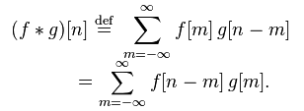

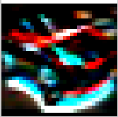

Signal
Math
Convolution
Image
Edge
Blur
-1
-2
-1
4
7
4
0
0
0
7
10
7
1
2
1
4
7
4

Slide 3
Full Connection
Back Propagation
Neural Network

